Slide 1

Module 0
Python Programming
Notes:
Guidelines
Use section headers to chunk content in your presentation.
Use the same style of section header throughout your presentation.
Keep your title to no more than 2 lines.

Slide 2

Python Basics
Identifiers
Notes:
Guidelines
Use a title slide at the beginning of your presentation. There are 9 variations of title slides to choose from.
If you will have a series of slideshows, we recommend using the same style of title slide for each presentation.
Keep your title to no more than 2 lines.
Do not change the font style or font size of the title or subtitle.

Slide 3
Identifiers
References to memory locations.
Identifier names are case-sensitive.
Must start with underscores ( _ ) or letters (a – z, A - Z)
Cannot be any reserved word.
E.g. of reserved words: None, True, False, and, or, not, if, else, elif, for, while, break, continue, pass, def, lambda, global, nonlocal, return, del, in, is, assert, class, try, except, finally, raise, import, from, with, as

Slide 4
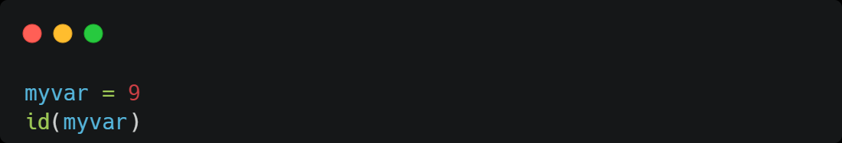
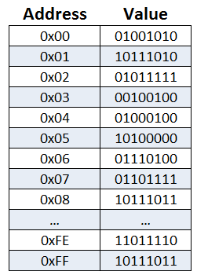
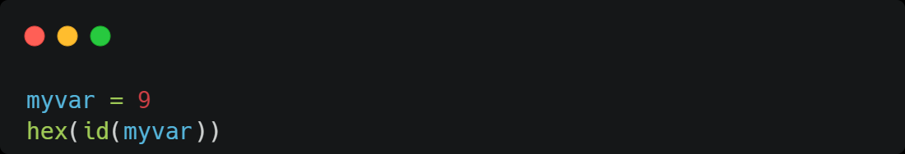

How to retrieve memory location?
139657602859504
0x7f0491cf01f0
myvar
0x7f0491cf01f0

Slide 5
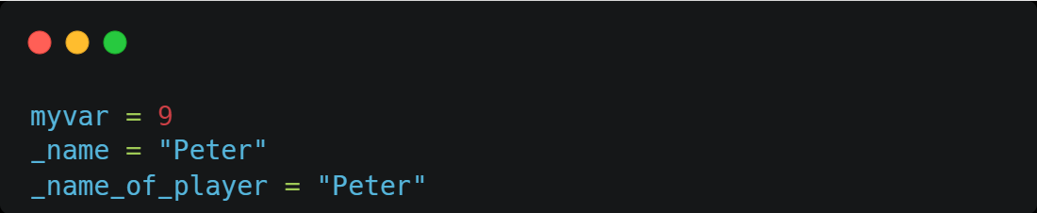

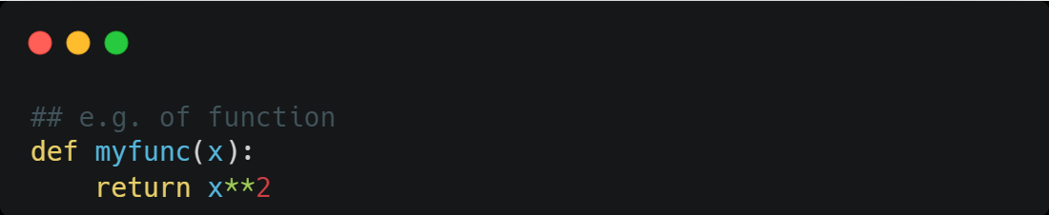
Valid Identifiers

Slide 6
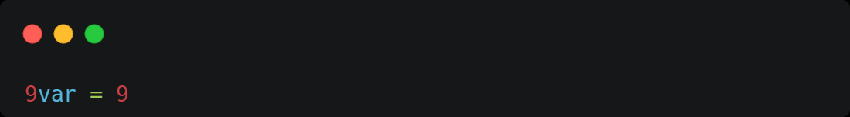

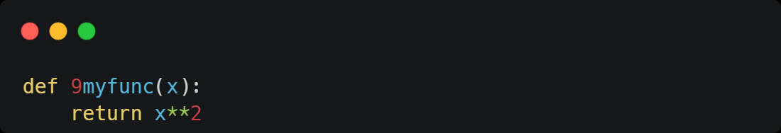
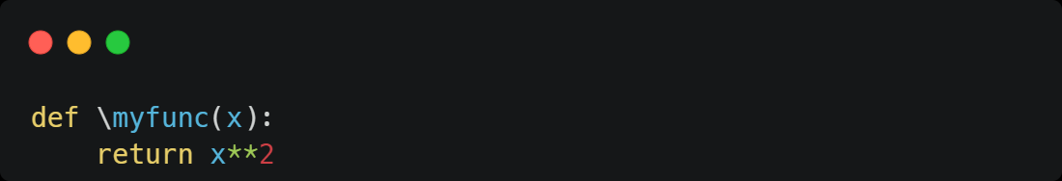
Invalid Identifiers
SyntaxError: invalid syntax

Slide 7
Python Basics
Class Types
Notes:
Guidelines
Use a title slide at the beginning of your presentation. There are 9 variations of title slides to choose from.
If you will have a series of slideshows, we recommend using the same style of title slide for each presentation.
Keep your title to no more than 2 lines.
Do not change the font style or font size of the title or subtitle.

Slide 8
Classes
The main types of classes are:
Integers: int
Floats: float
Strings: string
Booleans: bool

Slide 9
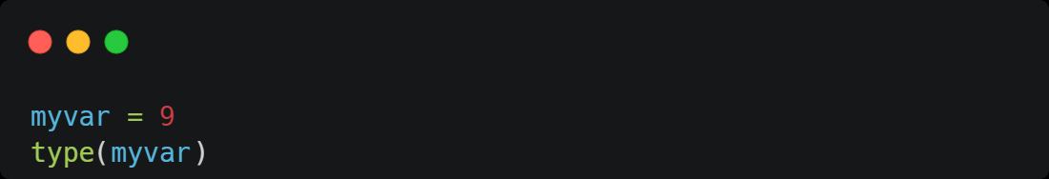
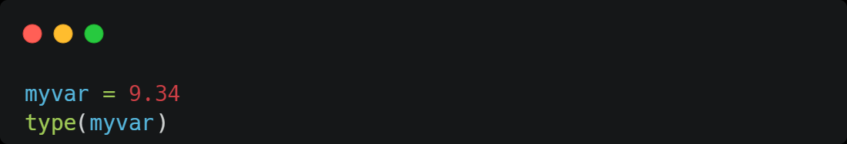
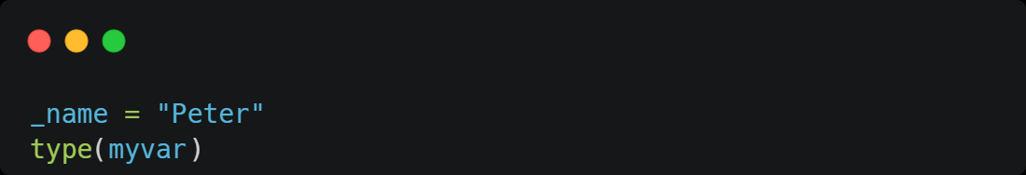
Class Types
int
float
str

Slide 10
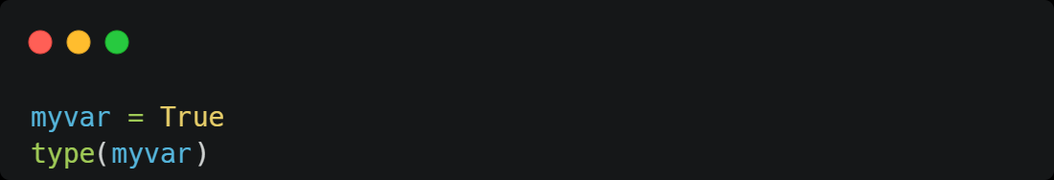
Class Types
bool

Slide 11
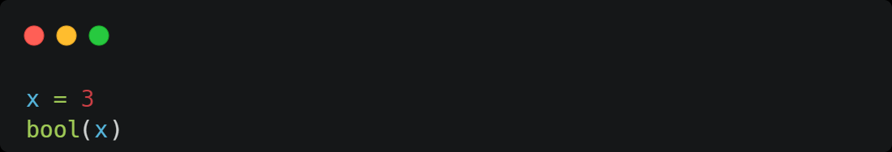

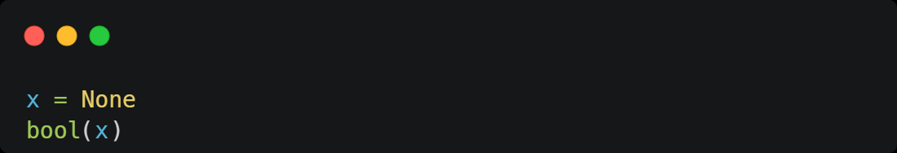
Truthiness of Objects and Conditions
True
False
False

Slide 12
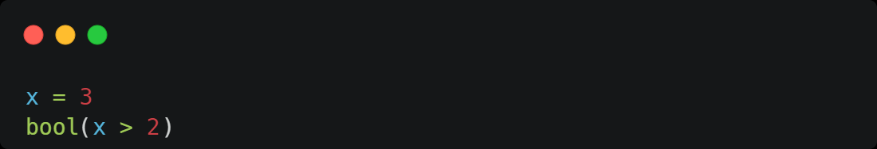
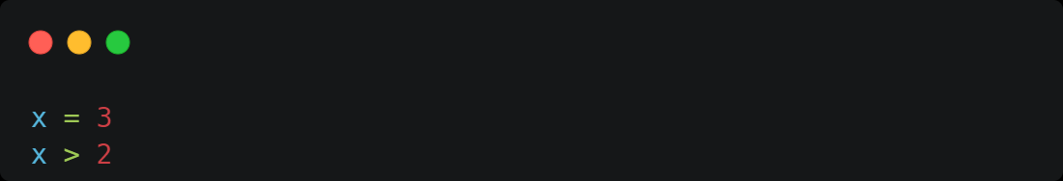
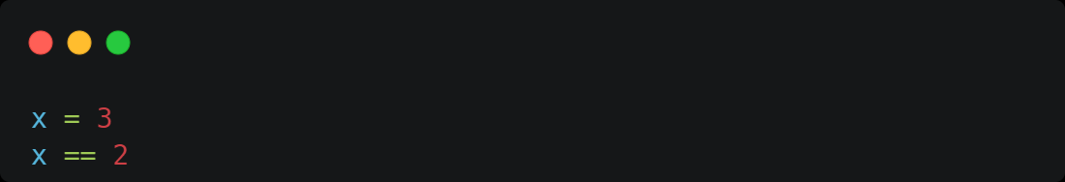
Truthiness of Objects and Conditions
True
True
False

Slide 13
Python Basics
Conditionals and Loops
Notes:
Guidelines
Use a title slide at the beginning of your presentation. There are 9 variations of title slides to choose from.
If you will have a series of slideshows, we recommend using the same style of title slide for each presentation.
Keep your title to no more than 2 lines.
Do not change the font style or font size of the title or subtitle.

Slide 14
Conditionals
A construct that allows you to branch your code based on conditions being met (or not)
if, elif and else or the ternary operator (aka conditional expression)

Slide 15
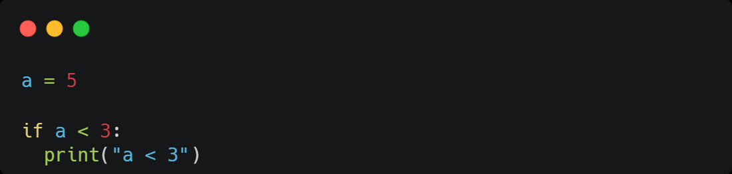
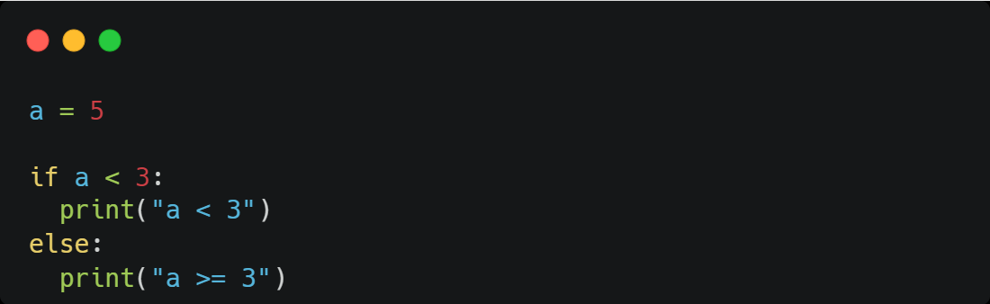
Conditionals
a >= 3

Slide 16
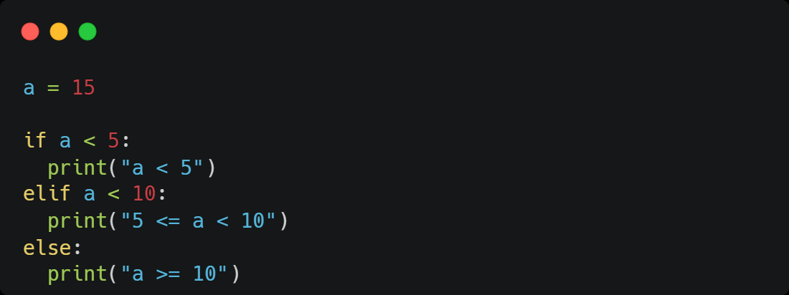
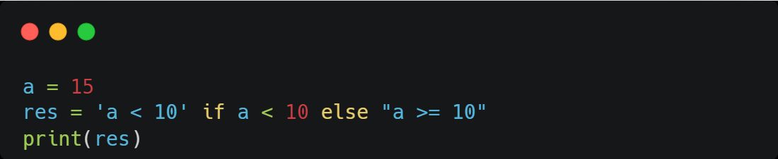
Conditionals
a >= 10
a >= 10

Slide 17

While Loop
repeats a block of code as long as a specified condition is True.

Slide 18
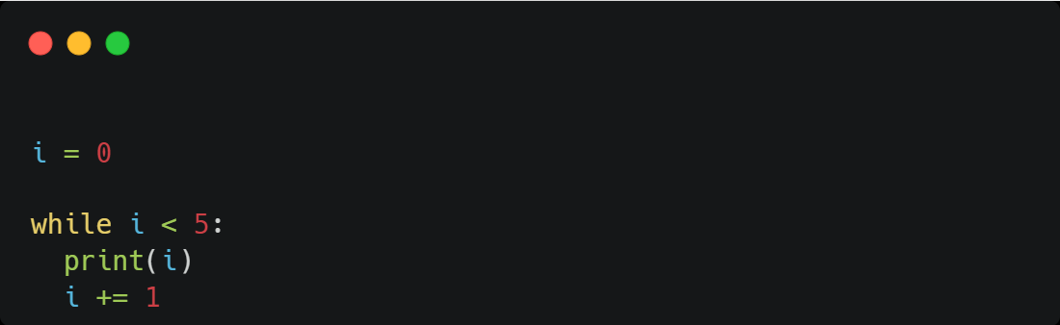
While Loop
0
1
2
3
4

Slide 19
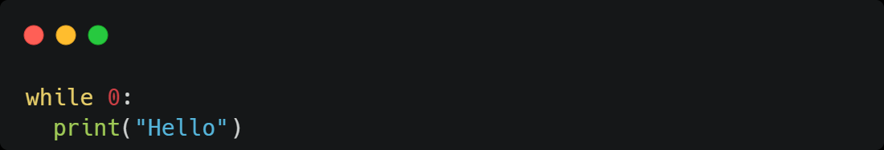
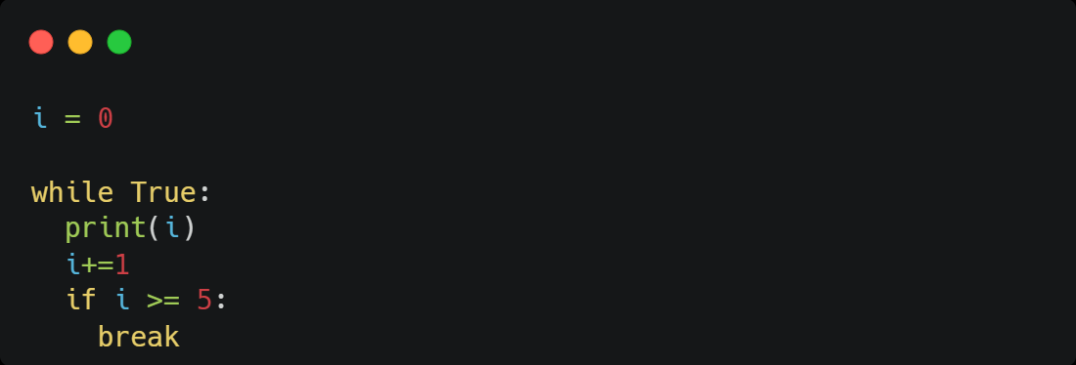
While Loop
0
1
2
3
4

Slide 20
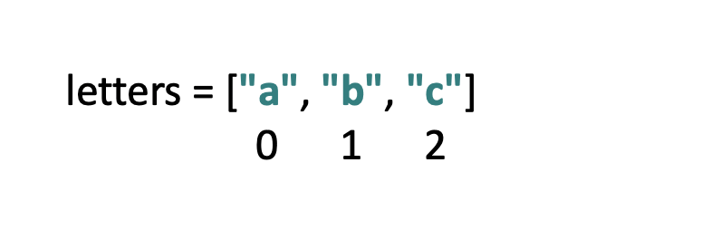
For Loop
Iterates (loops) over an iterable object.

Slide 21
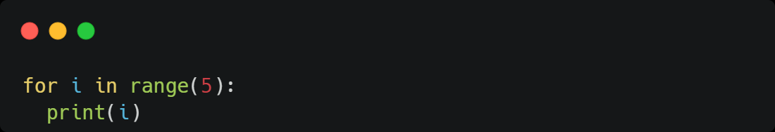
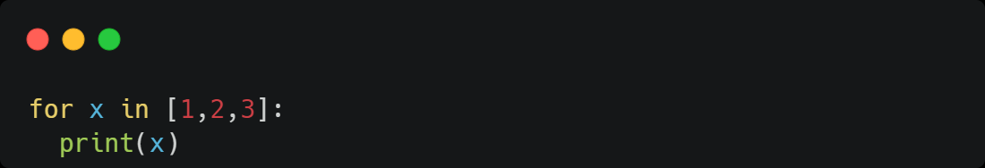
For Loop
0
1
2
3
4
1
2
3

Slide 22
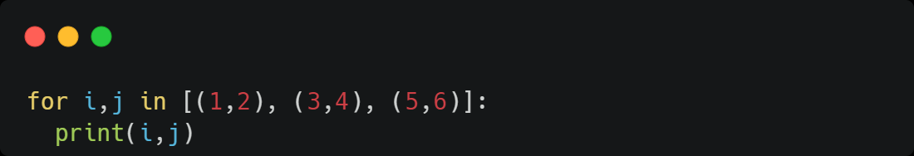
For Loop
1 2
3 4
5 6

